Slide 1

A Parallel Algorithm Template for Updating Single-Source Shortest Paths in Large-Scale Dynamic Networks
Presented By :
M. Azeem Ashfaq 22I-1057
M. Bilal Tariq 22I-1297
M. Nabeed Haider 22I-0871

Slide 2
Introduction to Dynamic Networks and SSSP
Dynamic Nature
Importance of SSSP
Challenges
Real-world graphs constantly change with edges and nodes updating continuously.
Single-Source Shortest Path is key for routing, centrality metrics, and recommendations.
Recomputing SSSP from scratch after every change causes huge computational overhead.

Slide 3
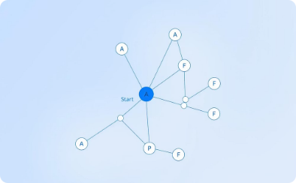

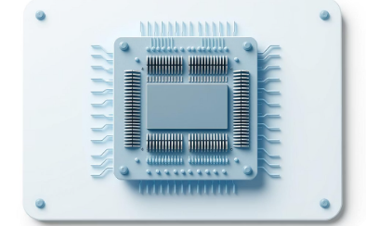

Background & Related Work
Static SSSP Algorithms
Parallel Static SSSP
Shared Memory Parallelism
Research Gap
Gunrock uses GPU for high throughput on fixed graphs with parallelism.
Existing methods do not efficiently handle dynamic updates; they recompute fully.
Dijkstra and Bellman-Ford are foundational methods for shortest paths.
Galois offers CPU-based parallel Dijkstra for static graphs.

Slide 4
Motivation: Dynamic Networks and SSSP Challenges
Real-World Relevance
SSSP Problem
Many complex systems—such as social, biological, and communication networks—are modeled as large, dynamic graphs. Their structures change over time, requiring fast, scalable analysis methods.
The Single Source Shortest Path (SSSP) problem is foundational for network analysis, supporting metrics like closeness and betweenness centrality. Existing parallel algorithms often assume static graphs, limiting their utility for dynamic scenarios.
Millions of nodes and billions of edges
Applications in transportation, cybersecurity, and more
Need for efficient, platform-independent updates
Scalability is critical for exascale computing

Slide 5
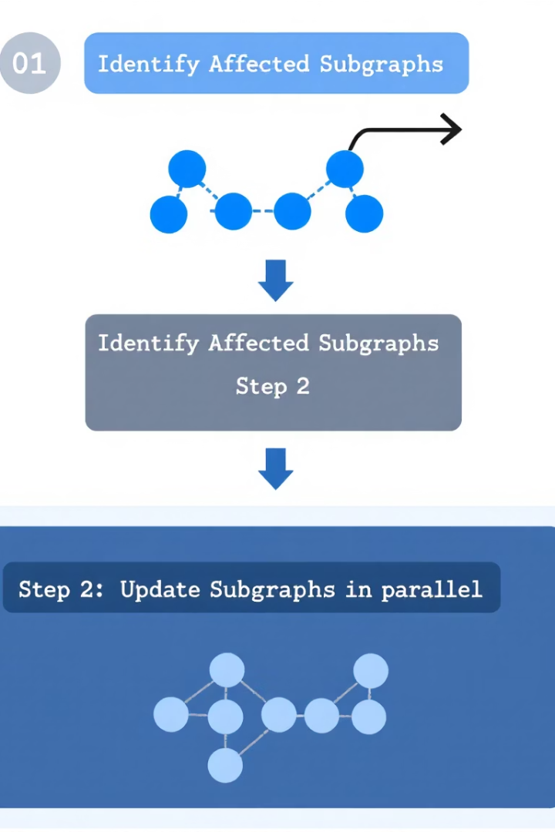
Framework Overview: Parallel SSSP Updates
Key Idea
Two-Step Process
Identify and update only the subgraphs affected by network changes, rather than recomputing the entire SSSP tree.
Step 1: Detect affected vertices in parallel. Step 2: Update these subgraphs, synchronizing only as needed.
Platform Independence
The framework is designed to be implemented efficiently on both shared-memory CPUs and GPUs, enabling broad scalability.

Slide 6




Algorithm Details: Data Structures & Parallel Steps
Rooted Tree Structure
The SSSP is stored as a rooted tree, with each vertex maintaining its parent, distance from the root, and flags for affected status.
Parallel Edge Processing
Edge insertions and deletions are processed in parallel to mark affected vertices, minimizing synchronization.
Iterative Updates
Affected subgraphs are updated iteratively, converging to correct distances without expensive locking mechanisms.

Slide 7
Implementation: Shared-Memory and GPU Approaches
Shared-Memory (CPU)
GPU Implementation
Uses OpenMP for parallelism, processing edge changes in batches. Asynchronous updates reduce synchronization overhead, and batch processing improves load balancing for large updates.
Employs CUDA and a Vertex-Marking Functional Block (VMFB) to parallelize marking and updating affected vertices. The approach leverages massive thread parallelism and efficient data structures like CSR.

Slide 8

High-Level Approach
1. Identify affected vertices (edge‑level parallelism)
2Update affected subgraph (iterative, lock‑free relaxations).
Converge to new SSSP tree with minimal work.

Slide 9
Step 1 – Identify Affected Vertices
Deletions: Mark entire subtree if the deleted edge was in the SSSP tree.
Insertions: Mark endpoint if the new edge shortens a path.
Fully Parallel Processing: Each changed edge is processed independently without synchronization.

Slide 10
Step 2 – Update Affected Subgraph
Lock-Free Convergence
Iterative Relaxation
No locking needed; iterations converge to accurate shortest paths efficiently.
Disconnect Marked Subtrees
Repeatedly update distances among marked vertices and their neighbors.
Set distances of affected vertices to infinity to begin recalculation.

Slide 11
Time Complexity & Scalability
Overall Efficiency
Step 2: Update Affected Subgraph
Combined complexity O(m/p + D × d / p) scales well when the affected region is small.
Step 1: Identify Affected Vertices
Executes in O(Dxd / p)
Runs in O(m/p), dividing the work over p parallel processors.

Slide 12


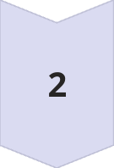
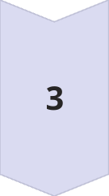
Conclusion & Future Directions
Novel Framework
Introduced a scalable, parallel template for updating SSSP in dynamic networks, validated on both CPU and GPU platforms.
Performance Gains
Achieved significant speedups over state-of-the-art recomputation methods, especially for insertion-heavy workloads.
Next Steps
Future work includes hybrid strategies that dynamically choose between updating and recomputing, and predictive algorithms for further optimization.

